Slide 1



PHARMA
Buddy
Group 01
202114006 Afra Anan
202114008 Ahmad Abdullah
202114036 Maisha Tabassum
202114060 MD Zakaria Hossen Emon

Slide 2

Introduction
Today's
Topic
Frontend Technologies
Backend Technologies
Database
System Architecture
Hosting & Deployment
Features
Versions
Limitations
Time Management
Future Work
Time Management

Slide 3
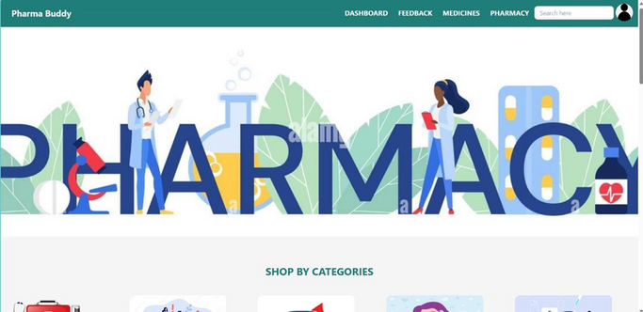
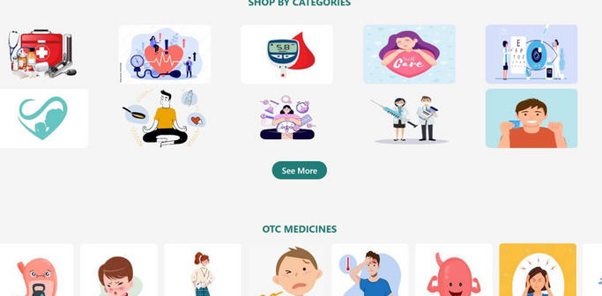
Introduction
The developed web-based application serves as a valuable tool for users seeking streamlined management of their medical requirements. With a focus on enhancing user convenience, the platform enables individuals to easily locate nearby pharmacies, verify medicine availability, compare prices. This application plays a crucial role in promoting transparency within the medicine market, empowering users to make well-informed decisions regarding their healthcare purchases.

Slide 4


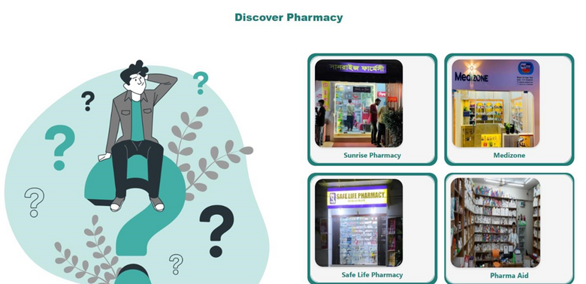
Frontend Technologies
The frontend of the platform is developed using:
• React JS: For building a dynamic and responsive user interface.
• HTML: The backbone of the website's structure.
• Tailwind CSS: For styling and designing a modern, user-friendly interface.

Slide 5
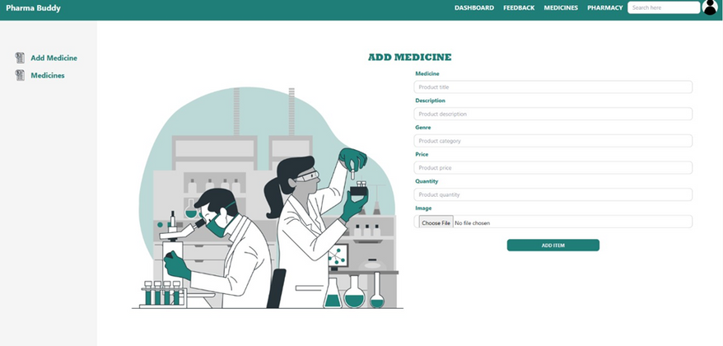
Backend Technology
The backend of the platform is built using:
1.Node JS: As the primary runtime environment for executing the server-side code.
2.Express JS: To handle and manage server requests efficiently.

Slide 6

Database
MongoDB is used as database

Slide 7





The system architecture follows a client-server model. The frontend and backend components will communicate via API calls. The frontend will send requests to the backend, which will process the data and provide responses. This architecture ensures a separation of concerns, scalability, and maintainability.
Client-side
Server-SIDE
System Architecture
Database

Slide 8
Hosting
&
Deployment
Frontend
Frontend of the project is hosted in netlify.com
Backend
The projects backend is deployed in render.com

Slide 9

Features
View Medicine List
Registration
Login
Pharmacy Dashboard
Add Medicine to Cart
Admin Dashboard

Slide 10
Features
User dashboard
View Existing Pharmacy
User Feedback
Purchase History
View Medicines Under Pharmacies
Sort by Price

Slide 11
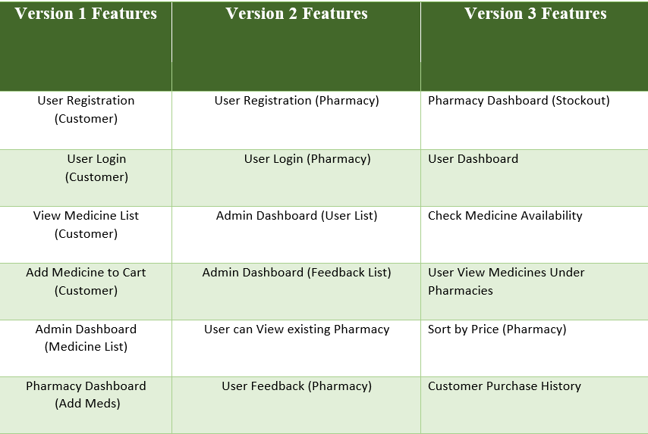
Versions

Slide 12

Limitations
1. The platform does not include a system for delivering products to users.
2.Users cannot change the language of the platform, limiting accessibility for non-English speakers.
3.The absence of a live chat feature restricts real-time communication between users and support.
4. There is no distance based sorting for medicines which could save time for the users

Slide 13

Future Scope
1.Consider developing a mobile app in the future to expand accessibility and reach a wider audience.
2.Implement features like live chat to improve real-time communication between users and support.
4.Consider empowering admins with the ability to manage accounts based on user ratings, ensuring platform quality.
5.Explore the possibility of integrating a product delivery system for added convenience.

Slide 14
TIME MANAGEMENT
Frontend Design - Week 3
Frontend Design Finalization &
Implementation Begin - Week 4
Finalizing Frontend - Week 5
Debugging & Rectifying Issues - Week 6
Completion of Front End - Week 7
Back end Development begin - Week 8
Implementing User Access Control - Week 9
Completion of Back End - Week 10
Integration of Back End & Front End - Week 11-12
Application Hosting & Deployment - Week 13
Final Project Presentation - Week 14

Slide 15

Thank
You

